Slide 1
Data Capacity During a Crisis
National Community Action Partnership
April 28, 2021

Slide 2

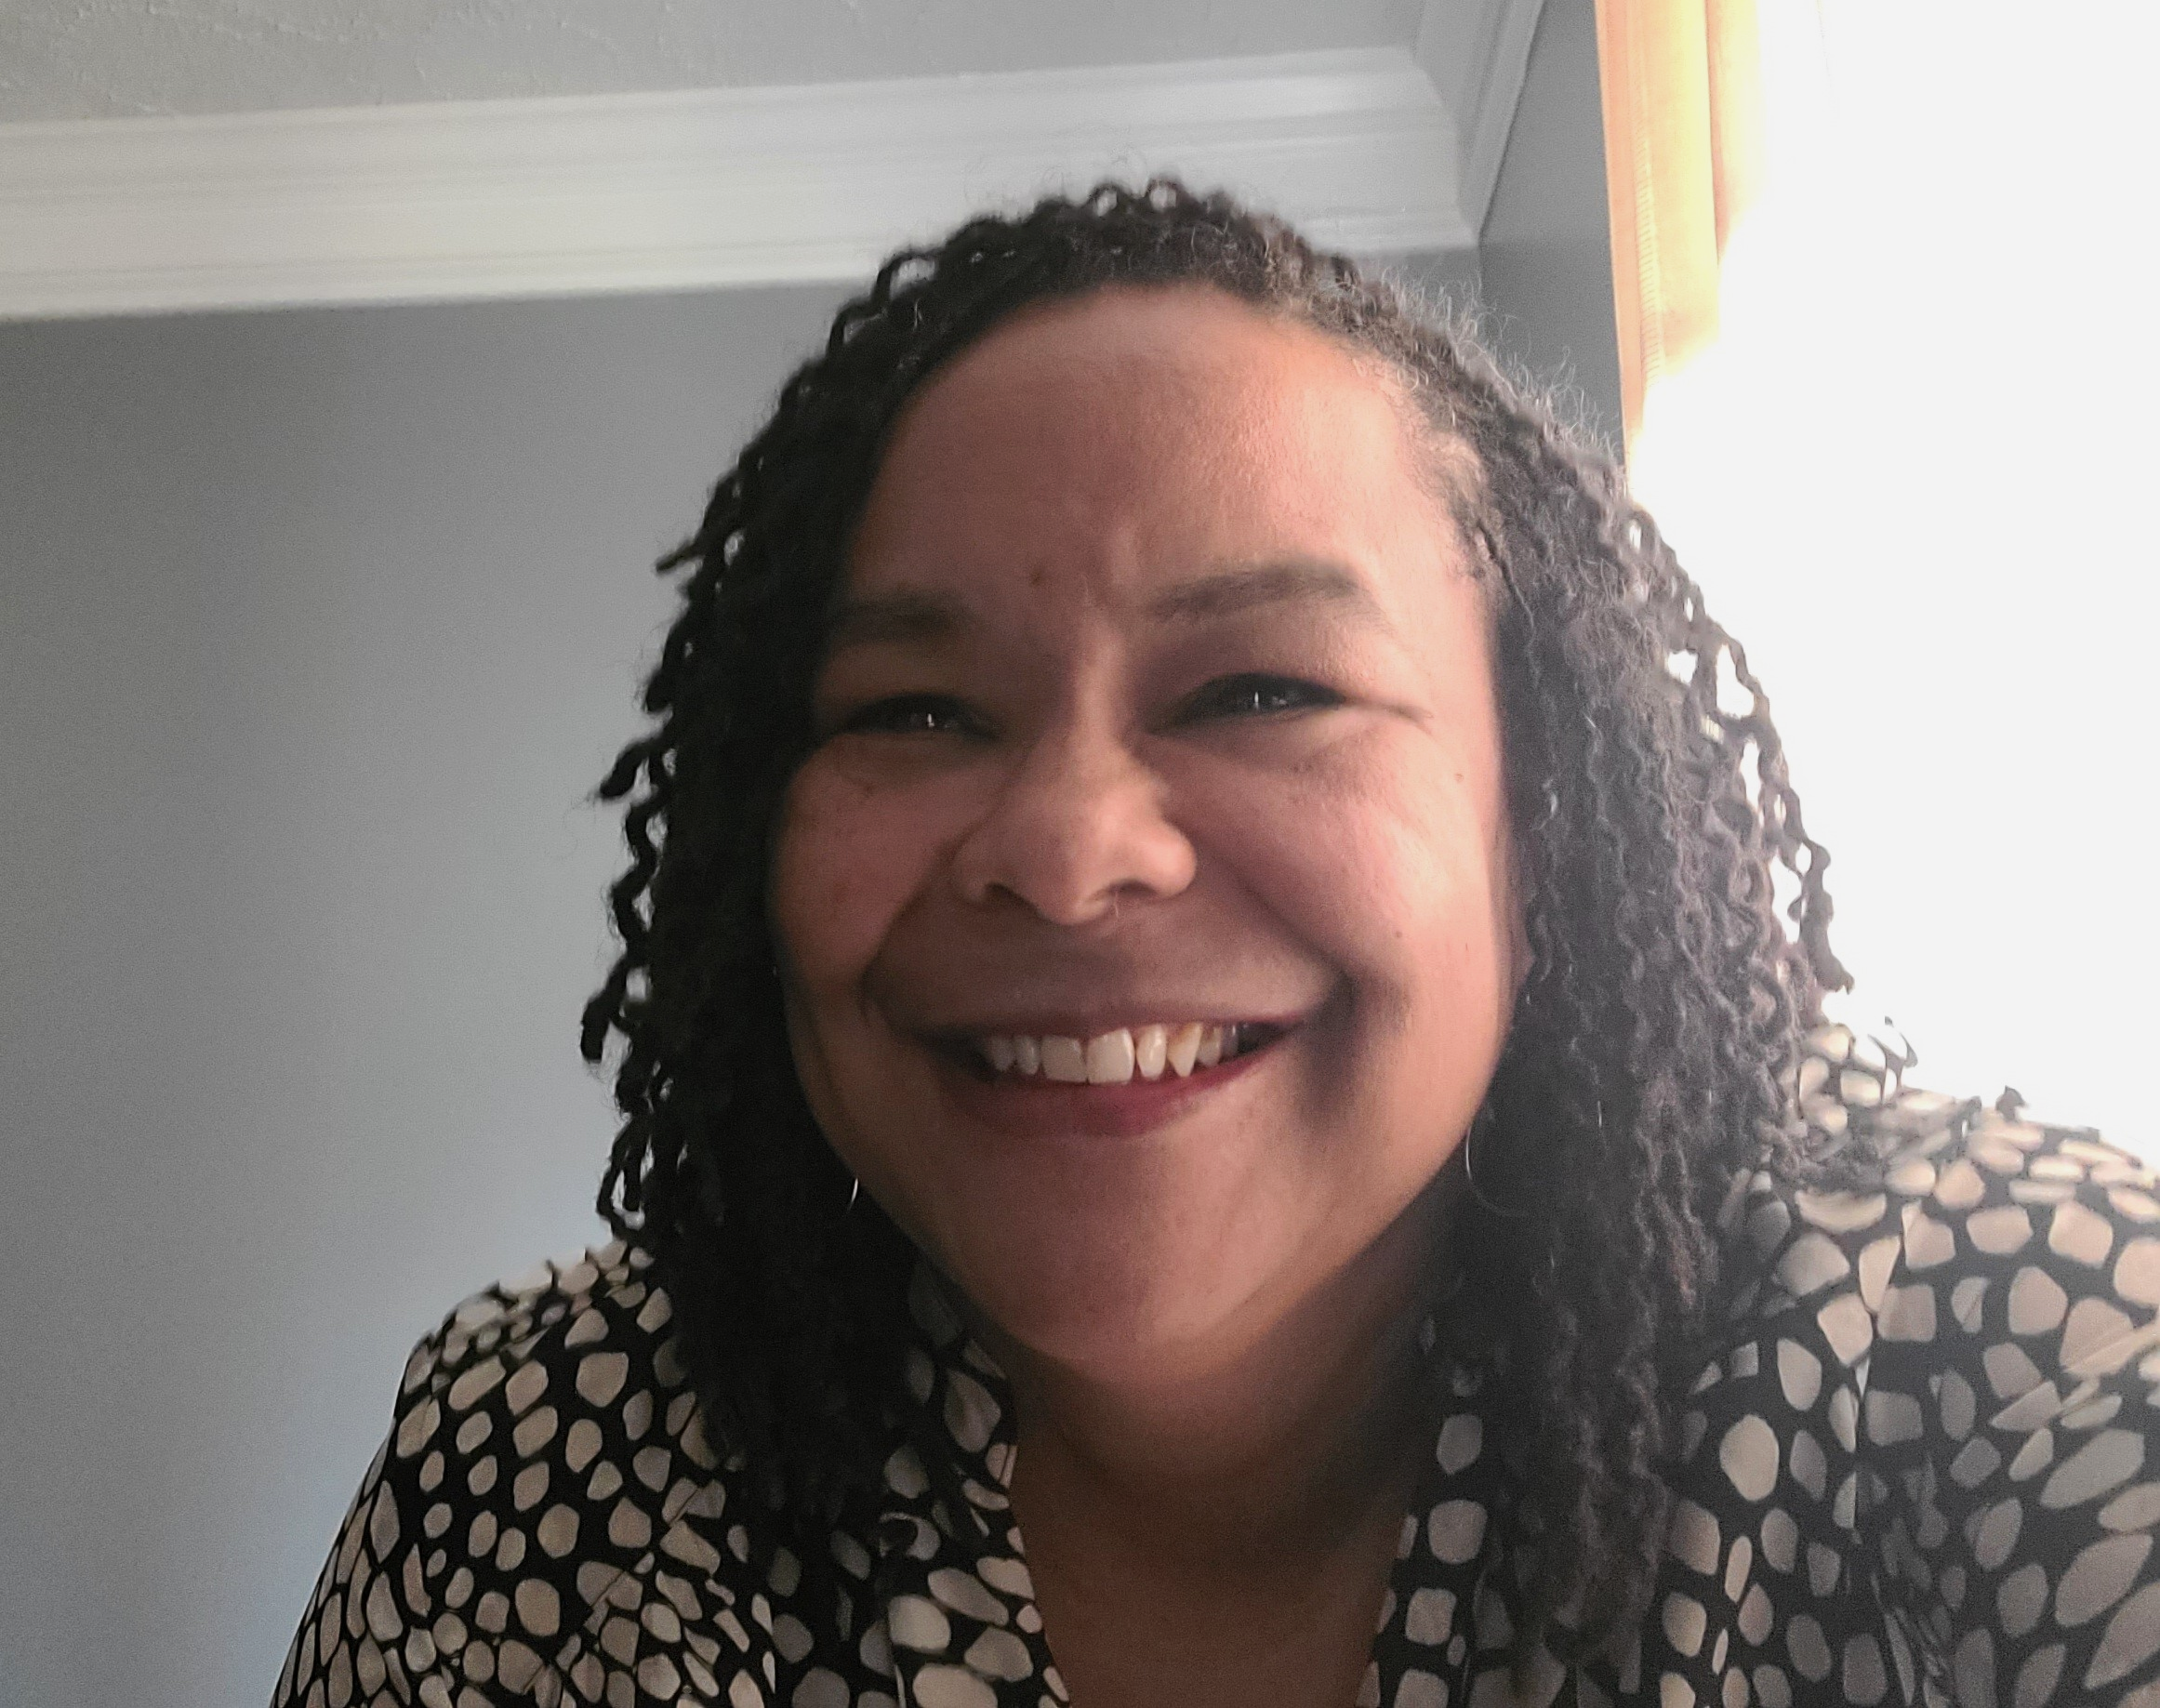

Today’s Presenters
Amanda Thomson
James Bell Associates
T’Pring Westbrook, Ph.D.
The Annie E. Casey Foundation
Erika Williams
The Albireo Group

Slide 3
Session Objectives
Attendees will:
  Learn how quality data supports quality programming
  Gain deeper knowledge of data capacity and data governance
  Be introduced to the Data Governance Tool Kit
  Learn how two-generation programs have used data governance planning as a transformative process
  Be invited to join an online community of other organizations using data governance planning to build their data capacity and transform their work

Slide 4

Getting to Know You
Please take a minute to answer our poll!
How would you describe your role at your agency?
How familiar are you with the term “data governance”?

Slide 5
Let’s Talk Data Capacity and Data Governance
5

Slide 6


Two-Generation Program Context
DATA
VITA
DATA
Job Skills
DATA
Housing Assistance
(Volunteer Income Tax Assistance)
Child Care
DATA
Food Pantry
DATA
DATA
DATA
Speech Therapy
DATA
ESOL Classes

Slide 7

Defining Data Capacity
Data Capacity
Policies Capacity
Data
Access
Data
Sharing
Technical Capacity
Hardware
Staff
Capacity
Data
Privacy
Software
Information Technology
Data Operations
Leadership
Defining Data Capacity for Two-Generation Programs
Resource Alert!

Slide 8
Let’s Get Chatty
In the chat box, quickly tell us:
In which capacity area is your organization strongest?
Which area of capacity do you need more growth?
Data Capacity
Policies Capacity
Data
Access
Data
Sharing
Technical Capacity
Hardware
Staff
Capacity
Data
Privacy
Software
Information Technology
Data Operations
Leadership

Slide 9

What Is Data Governance?
Data
Governance
Measurements and information, both qualitative and quantitative, collected across programs and departments (such as human resources, finance).
An organization’s ability to effectively manage and utilize data to best support your program participants and enhance internal capacity.
DATA GOVERNANCE is the practice of organizing and implementing policies, procedures and standards for the effective use and management of an organization’s data.
9

Slide 10
Intersection of ROMA and Data Governance
Performance measurement
  ROMA is the system for performance measurement
  Data are the evaluative components for performance measurement
ROMA and data governance are comprehensive in scope
  Data governance — the practice of organizing and implementing policies, procedures and standards for the effective use and management of an organization’s data
  ROMA — sound management practice that integrates outcomes and results into a Community Action Agency’s administration, management, operation and evaluation of programs and services

Slide 11
Terminology Recap
Data Capacity
  Multifaceted concept that includes three key interconnected components: technical capacity, policies capacity and staff capacity
Data Governance Plan
  Written blueprint for organizing and executing data governance strategies for an organization
Data Governance Tool Kit
  Guide for developing a data governance plan

Slide 12
Data and You: Time to Get Real
12

Slide 13
Let’s Rap!
During COVID, what has been successful and what has been challenging related to data?
Put your answer in the chat.

Slide 14
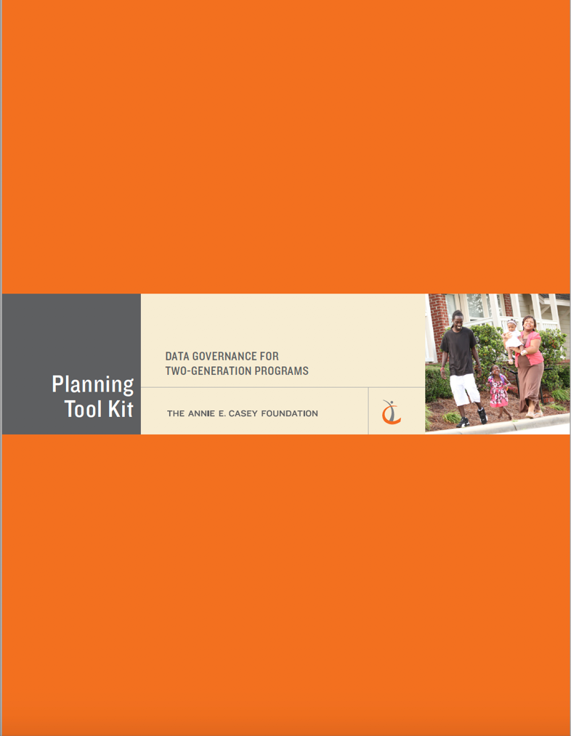
Data Governance – There’s a Tool Kit for That!
Let us tell you about the tool kit, and how it can help!
Data Governance for Two-Generation Programs Tool Kit
Resource Alert!

Slide 15
What Is the Data Governance Tool Kit and
How Can It Help?
15

Slide 16
Data Governance Tool Kit: Big Picture
The tool kit includes four modules focused on:
  Establishing the why (getting started)
  Building your team
  Assessing needs and setting priorities
  Reviewing the six core components of data governance
Resource Alert!
Data Governance Tool Kit Guiding Framework
16

Slide 17
Tool Kit Module:
The Six Core Components of a Data Governance Protocol
Data Security and Privacy
Data Collection
Data Change Management
Staff Training and Retraining
Communications Plan
Stakeholder Engagement

Slide 18
Data Governance: It’s a Process
Discovery
PHASE
Prepping
phase
Compilation
phase
Assessment
phase
revision
phase
Auditing data systems
Assessing readiness
Conducting baseline survey
Mapping of programs
  service and flow of families
  Data points and pain points (when things are harder
  than they should be;
  systems bump up against each other; duplication of forms; data entry)
(complete after each module)
Selecting the team
Setting priorities
Developing shared language
Determining a process
Completing relevant sections of data governance tool kit
Revisiting and revising
Reviewing and celebrating progress
Identifying what is actionable
Revisiting priorities
Sharing progress with relevant stakeholders
Resource Alert!
Infographic: Phases of Data Governance for Two-generation Programs

Slide 19
What Are You Interested In?
Please take a minute to answer our poll!
What core component of the tool kit is most interesting to you and your organization?

Slide 20
How Real-life Organizations Used the Tool Kit
20

Slide 21
The Process for Completing the Data Governance Tool Kit in Real Life
Discovery
PHASE
Prepping
phase
Compilation
phase
Assessment
phase
revision
phase
Auditing data systems
Assessing readiness
Conducting baseline survey
Mapping of programs
  service and flow of families
  Data points and pain points (when things are harder
  than they should be; systems bump up against each other; duplication of forms; data entry)
(complete after each module)
Selecting the team
Setting priorities
Developing shared language
Determining a process
Completing relevant sections of data governance tool kit
Revisiting and revising
Reviewing and celebrating progress
Identifying what is actionable
Revisiting priorities
Sharing progress with relevant stakeholders

Slide 22
Pilot Evaluation
Five very different organizations tested the tool kit.
Through surveys, focus groups, site visits and interviews we learned about their experiences with the tool kit.
After a year of working on the tool kit, we analyzed the data.

Slide 23
Lessons Learned
The process isn’t linear; organizations started or prioritized different modules based on their needs.
Teamwork is essential, especially with involvement from executive directors.
The planning and “getting ready” stages are critical.
It takes time.

Slide 24
Lessons Learned
Monthly Average Staff Hours Spent Preparing for Meetings and Spent in Meetings
AVERAGE TIME
IN
HOURS
5.15
2.63
preparing
in meetings
Notes:
Monthly, individual staff spent almost 8 hours working on the toolkit, with over 5 hours spent in meetings and an additional 2 and a half hours preparing and working outside of meetings

Slide 25
It Was Worth It
Organizations faced challenges like protecting time and turnover, but they said it was worth it.
Highlights:
  One organization reprioritized funds for a data role
  One organization changed and rewrote an RFP for a data system that was better able to meet their needs based on tool kit work
  Several programs noted tool kit work unintentionally broke down silos and led to learning about other programs.
  One organization was able to define agency data questions and data ownership rules
  Organizations noted it informed CQI and changed culture

Slide 26
Conclusion
26

Slide 27

Final Thoughts
“The ability to access data through an integrated data system is extremely important to the provision of comprehensive, integrated whole family work.”
“Data capacity is the ability to have the right data, at the right time, in the right form, to the right people.”
Paige H. Teegarden, general manager, empowOR by CSST Software
Wonda Winkler, executive vice president, Brighton Center

Slide 28
Resources
Data Governance Tool Kit: www.aecf.org/resources/data-governance-for-two-generation-programs
Guidance Document for the Tool Kit: www.aecf.org/m/resourcedoc/aecf-datagovernancefortwogen-framework-2019.pdf
Data Capacity Brief: www.aecf.org/m/resourcedoc/aecf-datagovernancefortwogen-brief-2019.pdf
Data Governance Infographic: www.aecf.org/m/resourcedoc/aecf-datagovernancefortwogen-infographic-2019.pdf

Slide 29
Contact us
T’Pring Westbrook, Annie E. Casey Foundation
  twestbrook@aecf.org; @TWestbrookPHD
Erika Williams, The Albireo Group
  erika@albireogroup.com; @aboutherbiz
Amanda Thomson, James Bell Associates
  Thomson@jbassoc.com
Allison Meisch, James Bell Associates
  meisch@jbassoc.com; @A_Meisch

